Slide 1

Tic-Tac-Toe Game
A Python-based Game with AI and GUI Implementation
Welcome to the documentation for our Tic-Tac-Toe game, a classic reimagined with modern programming techniques. This presentation will guide you through the game's implementation, featuring an AI opponent and a user-friendly graphical interface.

Slide 2
Team Member's:
Bahaa Mahmoud Helmy
Waseam Nashat Samir
Selvana Atef Kadry Zekri
21-00550
21-01680
21-01588
Abdalla Shreif Mohammed
Maram Mohamed Ahmed
21-00242
21-00966

Slide 3
Introduction
Overview
Objective
A classic Tic-Tac-Toe game where the player competes against the computer.
Align three identical marks (X or O) horizontally, vertically, or diagonally to win.
Built using Python's Tkinter library for the graphical user interface.
The game can also result in a tie.

Slide 4
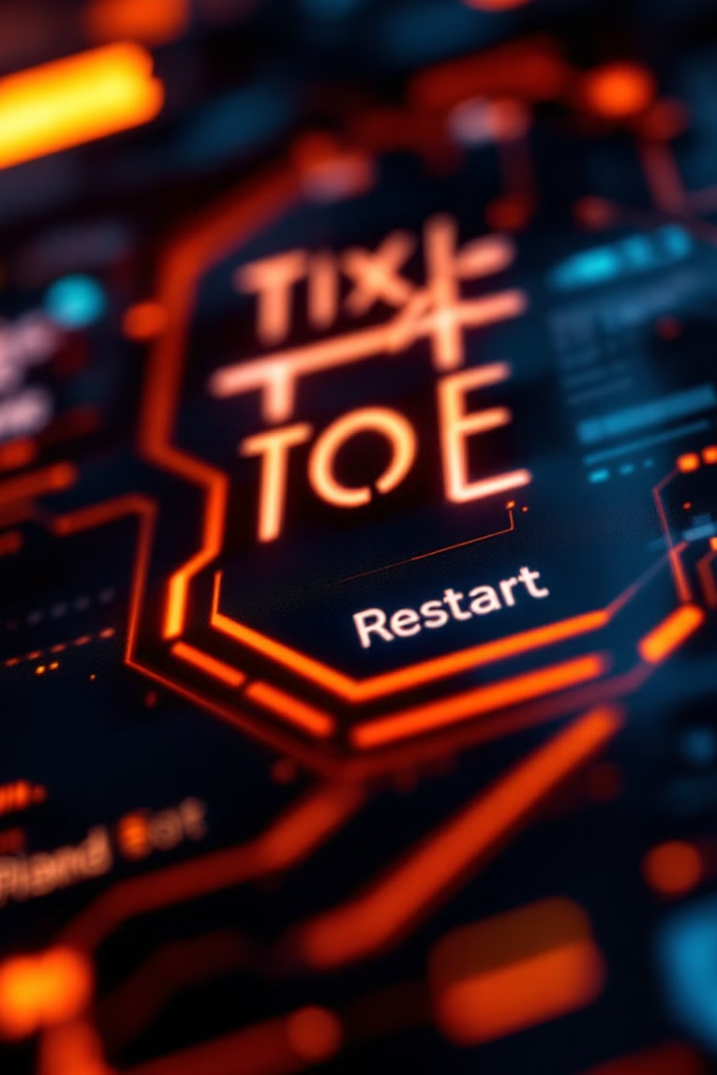




Key Features
Player vs Computer
Minimax Algorithm
Interactive gameplay against an AI opponent.
Ensures the computer makes optimal moves.
Simple GUI
Restart Button
Built using the Tkinter library for ease of use.
Allows restarting the game at any point.

Slide 5

Modules Used
Tkinter
Random
For creating the graphical user interface.
To simulate randomness in decision-making (if needed).

Slide 6
Core Functions
1
next_turn(row, col)
Handles the player's move and updates the board.
2
computer_turn()
Uses the Minimax algorithm to calculate the best move for the AI.
3
minimax(board, depth, is_maximizing)
Recursively evaluates the board to decide the optimal move.
4
get_best_move()
Determines the most strategic move for the AI.
5
check_winner()
Checks for a winner or a tie after each move.
6
start_new_game()
Resets the game board for a fresh start.

Slide 7





Game Flow
Initialization
The game starts with a 3x3 grid and the player's turn.
Player's Turn
Player clicks on a cell to place 'X'.
The system checks for a winner.
Computer's Turn
AI calculates the best move using Minimax.
Winner Check
After each move, checks for a winner or tie.
Restart
Players can reset the game anytime.

Slide 8
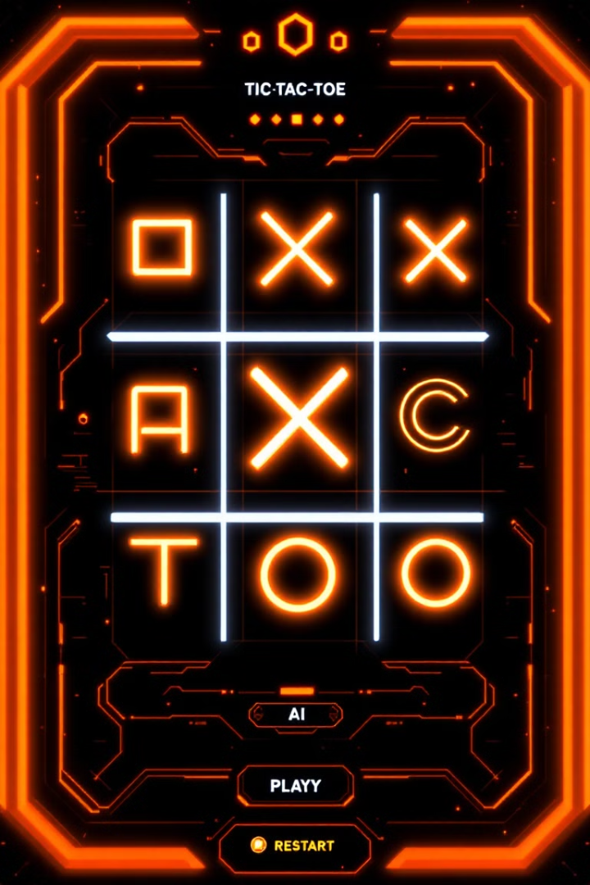
Example Use Case
1
Start
2
AI Move
Player begins by clicking a cell.
The computer calculates and places its move.
3
Alternate Turns
4
Restart
The process repeats until there is a winner or a tie.
Click the restart button to play again.

Slide 9
Code Structure Overview
Main Functions
Tkinter GUI
Minimax Algorithm
next_turn(), computer_turn(), minimax(), get_best_move(), check_winner(), start_new_game()
Window creation and button configuration.
Decision-making for the AI.

Slide 10



Future Improvements
Difficulty Levels
1
Hard AI settings.
Graphics Enhancements
2
Use custom icons for X and O.
Multiplayer Mode
3
Play vs Ai gameplay.

Slide 11

Conclusion
Summary
Learning Points
Combines classic gameplay with AI and GUI.
Python programming, Tkinter for GUI, and Minimax for AI.
A great demonstration of game logic and algorithmic decision-making.

Slide 12
